Slide 1
UVA WELLASSA UNIVERSITY MEDICAL CENTER MANAGEMENT SYSTEM
Group 03

Slide 2



Medical Center Serves all
students of the university,
staff members, with medical needs
User
Doctor
Pharmacist/Nurse

Slide 3
Project aims/objectives
Easiness in managing patients’ records and stock details increased.
Proper procedure to treat Academic and Non-academic staff can be introduced using a database.
Can easily access patients’ records through the system rather than searching the files
New students can be registered easily across the system.
Students can request a printed full medical report once leaving the university.

Slide 4
Progress of the Project
Requirements of the system was gathered.
The functional requirements were identified and specifications were understood.
The designing diagrams
use case and object class diagrams
were drawn.
ER diagram was drawn. The relations were mapped, and the sql syntaxes were created for the normalized relations.

Slide 5
Database was created.
90% of the interfaces of the system were designed.
Database connection was created.
Interfaces were linked together.
Implementation following functions were completed,
Login to the system
Adding a new user
Register a Student.
Update a Student
Delete a Student.

Slide 6
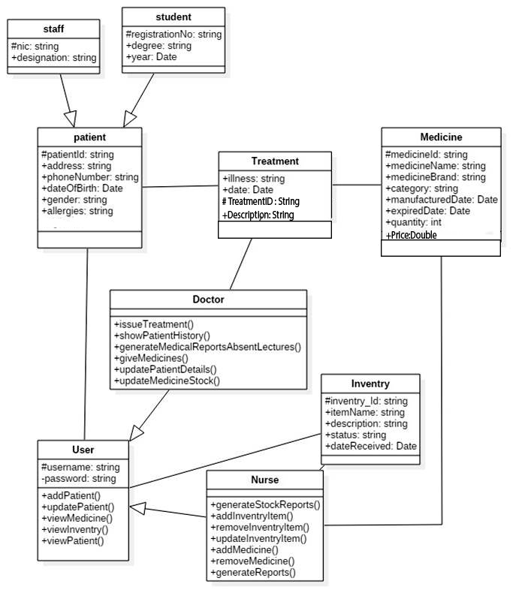
Class diagram
+RemovePatient()

Slide 7
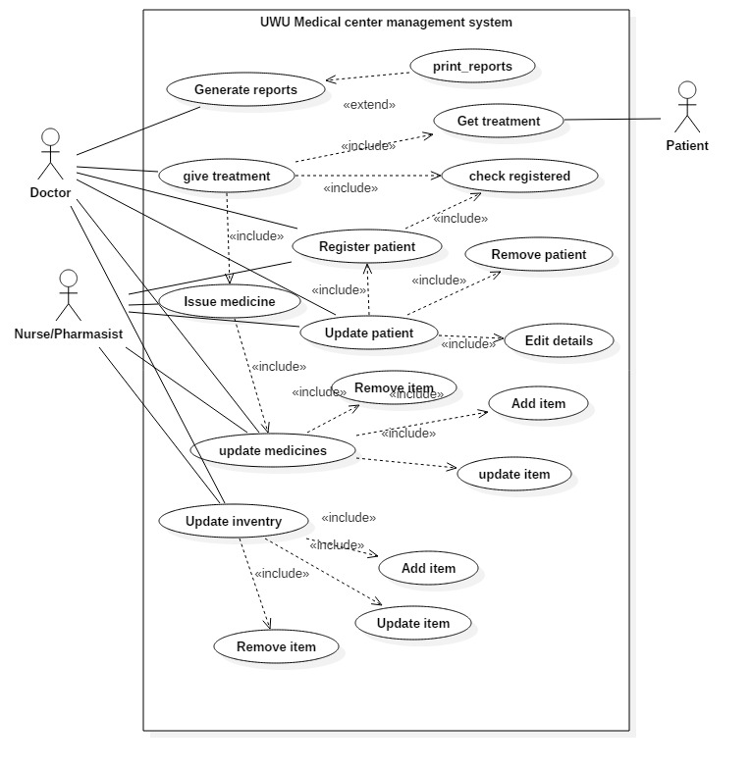
Use case diagrams

Slide 8
ER Diagram
Degree
Barcode
NIC
Designation
Staff
Rep_no
Reg_no
Student
Date
Report
Type
Batch
ISA
DOB
Alergies
generates
Description
1
1
N
Name
Username
M
PatientID
ISA
Doctor
Nurse/pharmasist
M
Illness
Prescribes
1
1
M
status
Dosage
has
Price
Quantity
M
N
M
Category
Medicine
MID
Brand

Slide 9
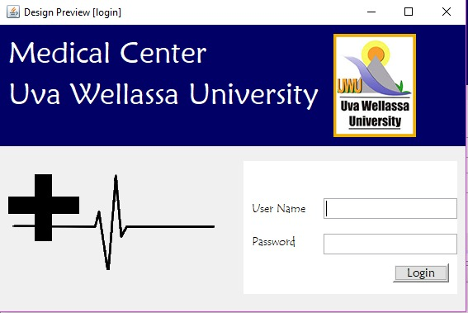
An interface
Using blue colour
Make the user easy
Font and the sizes
Few images

Slide 10
Future Work
Remaining implementations of the functions
Validations and the verifications
Deleting a patient, medicine, inventory item or a user is a critical function. Hence it was understood during the development that in the current development the deletion is not 100% secured. So it is planned to get user confirmation for the delete function through a pop-up window in further development.
In the logging out function which is not developed yet also, it is planned to use a pop-up window to get confirmation also.
Centralizing the database and connecting two computers
Final Testing of the System

Slide 11
Individual Contribution
No. | Name | Reg. No. | Individual Contribution
1 | Byravi T | UWU/CST/15/005 | Drawing of ER Diagram Creating progress report and presentation Designing interfaces and connecting interfaces
2 | Karunarathne K.R.R. | UWU/CST/15/016 | Designing interfaces and connecting interfaces Coding ER diagram drawing. Database designing. Creating progress report.
3 | Mathushanth S. | UWU/CST/15/027 | Designing interfaces and connecting interfaces Drawing use case diagram Creating progress presentation
4 | Sajitha S. | UWU/CST/15/039 | Drawing Class Diagram and Use case Diagram Creating progress report and presentation Designing interfaces and connecting interfaces.
5 | Wanigarathne J.A.G.A. | UWU/CST/15/052 | Drawing class diagram and ER mapping Database designing Creating project proposal presentation and report, progress report and presentation Designing interfaces Coding

Slide 12
Byravi T. UWU/CST/15/005
Karunarathne K.R.R. UWU/CST/15/016
Mathushanth S. UWU/CST/15/027
Sajitha S. UWU/CST/15/039
Wanigarathne J.A.G.A. UWU/CST/15/052

